Slide 1
Applied FHIR for Designers
Lloyd McKenzie
February 16-18, 2021

Slide 2

Who am I?
Name: Lloyd McKenzie
Company: Gevity
Background:
One of FHIR’s 3 initial editors
Co-chair FHIR Management Group and FHIR-Infrastructure
HL7 Fellow
Heavily involved in HL7 and healthcare exchange for 20+ years (v2, v3, CDA, etc.)
lmckenzie@gevityinc.com

Slide 3
This presentation
Can be downloaded here:
https://github.com/FHIR/documents/raw/master/presentations/2021-02%20Webinars/2021-02%20Applied%20FHIR%20for%20Designers.pptx
Is licensed for use under the Creative Commons, specifically:
Creative Commons Attribution 3.0 Unported License
(Do with it as you wish, so long as you give credit)

Slide 4
Learning Objectives
You should be able to:
Understand the different architectural approaches to using FHIR - and where to go to help decide the best approach for a given use-case (includes SMART, CDS Hooks, etc.)
Describe some of the considerations around persistence models when exposing a FHIR interface
Explain the technologies that FHIR provides to support terminology interoperability
Know the technologies that FHIR provides to document and define FHIR interfaces
Choose how best to leverage the FHIR community and maximize interoperability with existing solutions

Slide 5
Approach
Overview & context
List the architectural questions to be considered
Show an example of a FHIR test or production system
Explore those questions
Answer your questions
Repeat and see how far we get ☺
As hands-on as I can
Notes:
You will know where the interesting content is and where you want to explore more

Slide 6
Scenarios
EPIC test server
US Core Implementation Guide
Java Validator
International Patient Summary (IPS)
PrescribeIT® messaging interface
Structured Data Capture (SDC) & LHC Forms
Da Vinci CRD / DTR / PAS
Others?

Slide 7

EPIC test server
Notes:
Most major vendors have test servers, we’re going to explore one

Slide 8
Epic Test Server – Considerations
Choosing resources
Understanding the spec
Getting help
Extensions
Identifiers & References
Essence of a FHIR server
How to persist data
Interface version management
Security & Privacy

Slide 9
EPIC Test Server
Link path
http://hl7.org/fhir
https://confluence.hl7.org/display/FHIR/Public+Test+Servers
https://open.epic.com/Interface/FHIR
https://fhir.epic.com/Sandbox?api=932
https://fhir.epic.com/Sandbox?api=999
http://hl7.org/fhir/http.html
Notes:
How to find test servers
Try searching for a patient
Highlight that it shows headers & details
Human-readability, deep hierarchy, intuitive
Multiple concepts in a single resource
Can be business rules that drive behavior (try querying without category)
Where to find the full list of REST capabilities
Includes details like history, transactions, collision detection, conditional creates, etc.

Slide 10
Syntaxes
JSON
{ “B”: { “a” : “c” },
“C”: [ “One”, “Two” ],
“D” : [ “One” ],
“div” : {
“text-before”:“Not ”,
“b”:“so”,
“text-after”:“easy”}
}
XML
<XXX xmlns=“urn:foo”>
<B a=“c” />
<C>One</C>
<C>Two</C>
<D>One</D>
<div>Not <b>so</b> easy</div>
</XXX>
Notes:
XML vs. JSON vs. RDF
Support all?

Slide 11
When to use REST?
Want low coupling between systems
In theory, very little up-front negotiation required
Small, light-weight exchanges
Focus is CRUD operations
Also for publish/subscribe
Client-driven client-server orchestration
Server endpoint has fixed location
Well-suited for Mobile, PHR, Registries
Rest

Slide 12



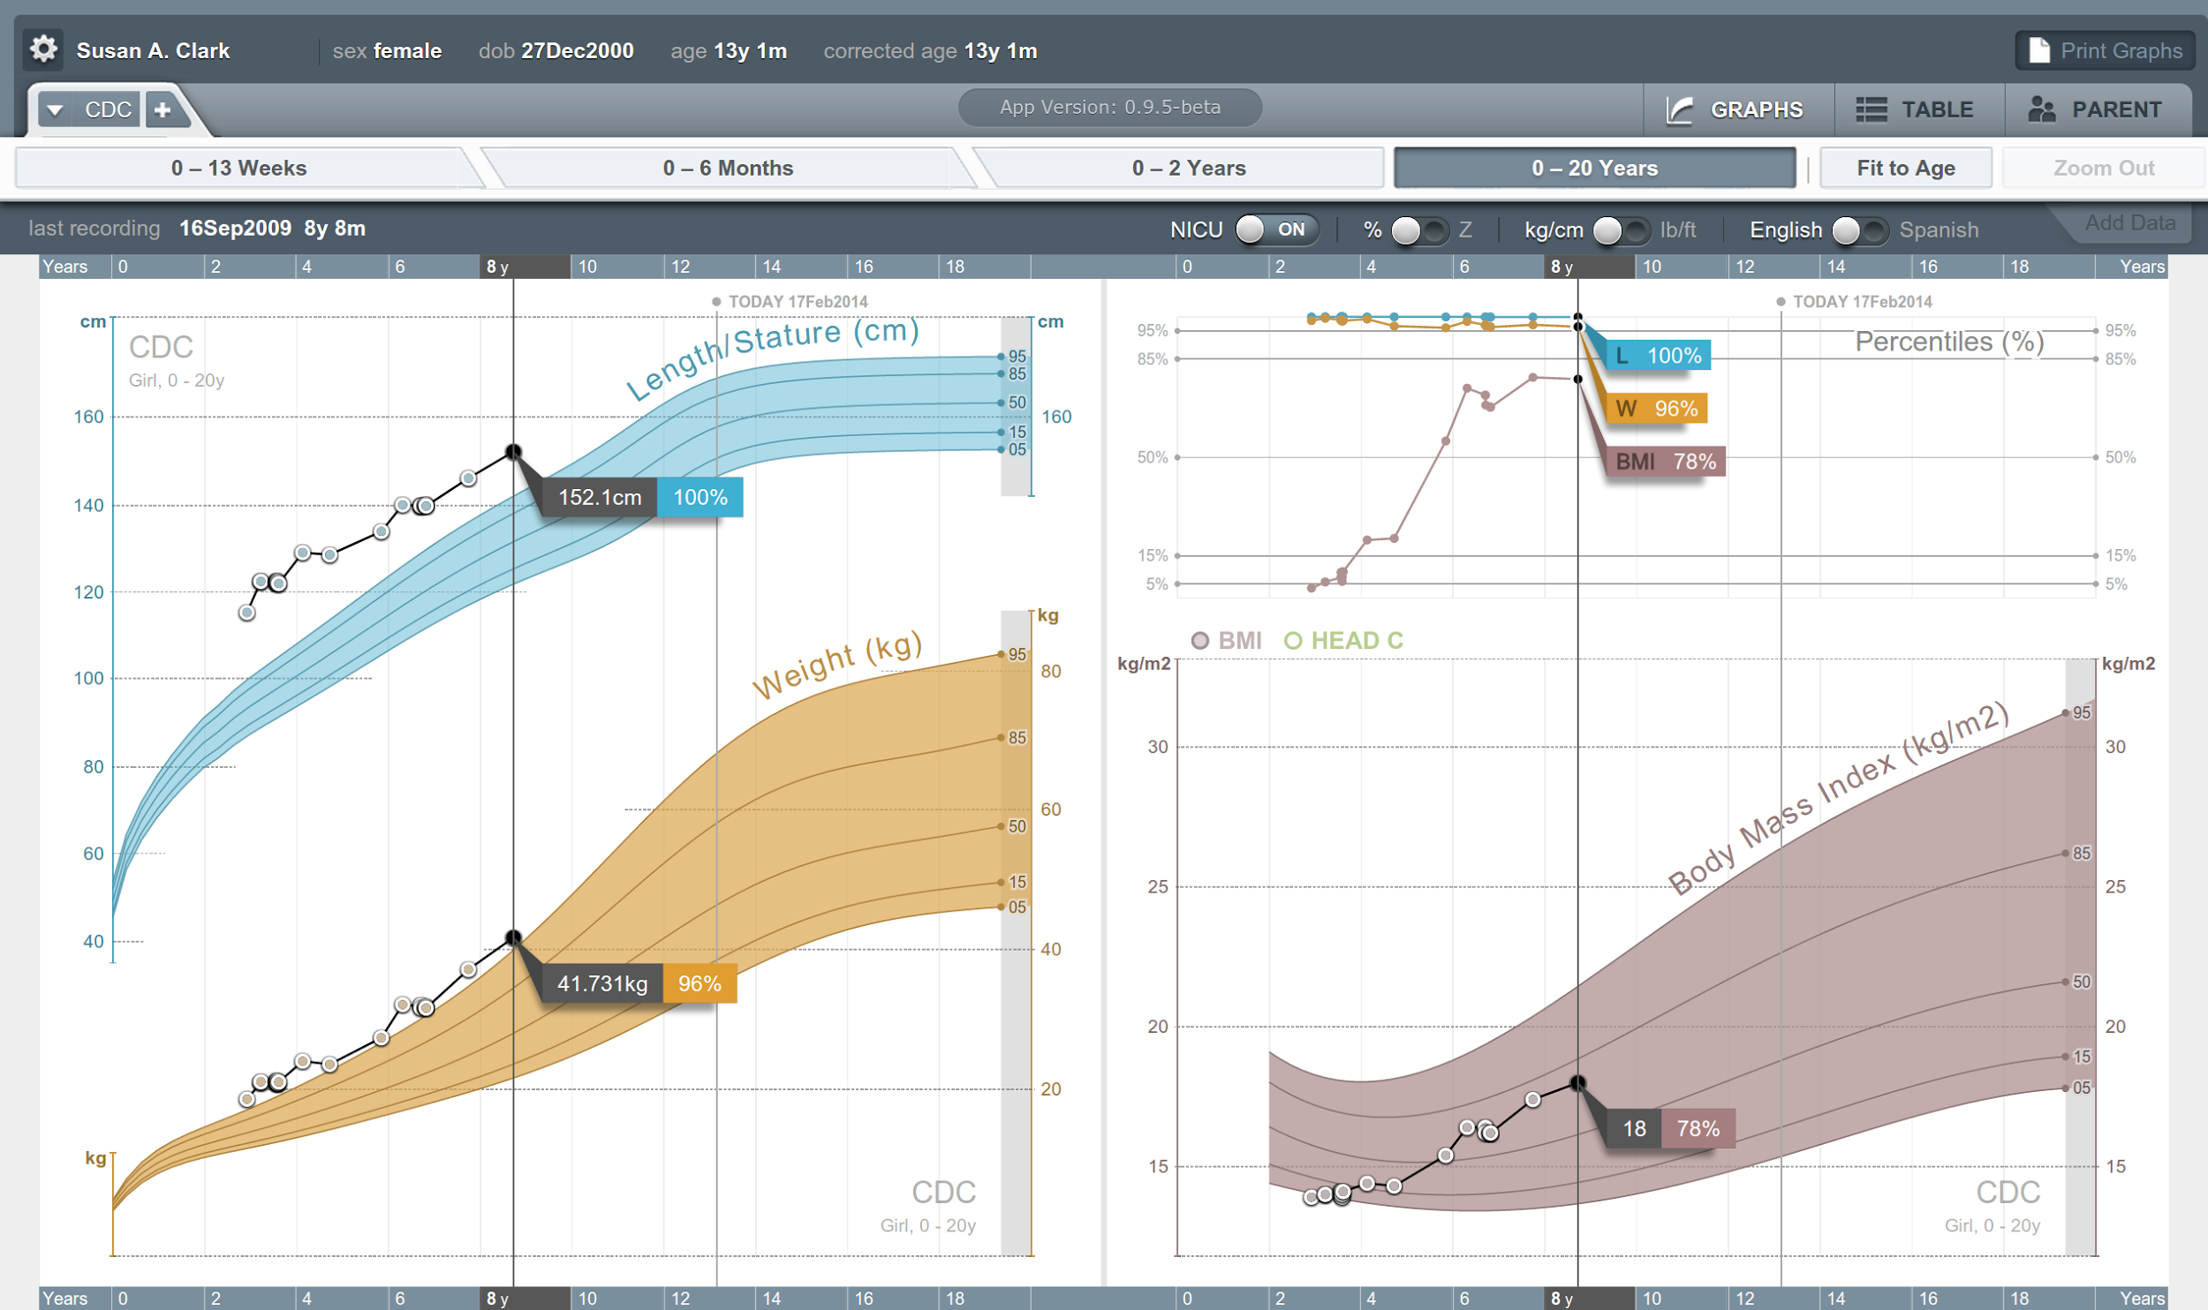


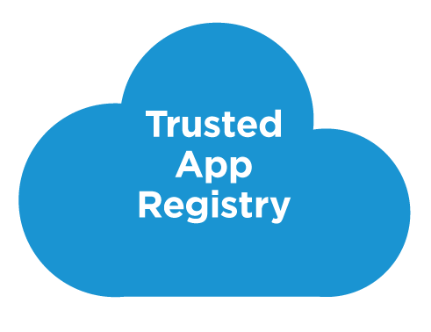



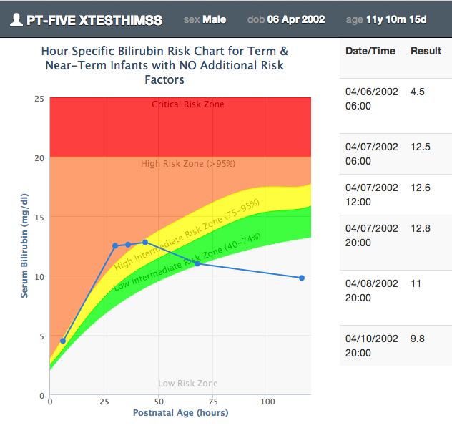







SMART on FHIR
Mobile Apps
Web Apps
OAuth2
REST API
MU-oriented FHIR Data Profiles
Underlying Health IT Systems
https://apps.smarthealthit.org
http://examples.smarthealthit.org/cardiac-risk-app
Your system here.

Slide 13
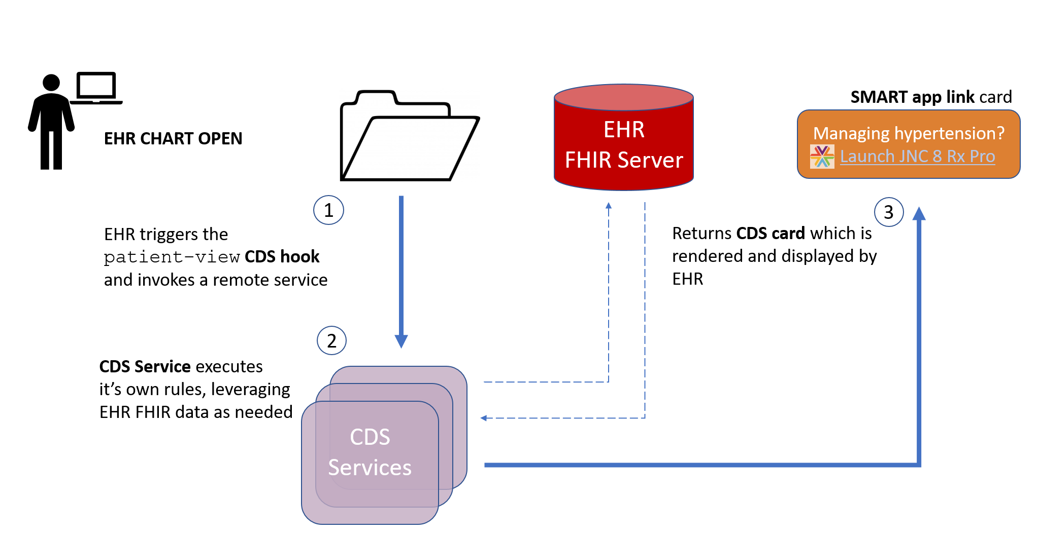
CDS Hooks
https://sandbox.cds-hooks.org
Notes:
Hypertension
Zestril

Slide 14
Selecting resources
Link path
http://hl7.org/fhir
https://www.hl7.org/fhir/resourcelist.html
Tabs
https://www.hl7.org/fhir/versions.html#maturity
http://www.hl7.org/fhir/search.cfm
https://www.hl7.org/fhir/observation.html
Notes:
Different ways of looking for resources
What does maturity mean – and should you use non-mature resources?
Using ‘search’ to find relevant content
Using the resource intro to understand scope

Slide 15
Understanding the spec
Link path
https://www.hl7.org/fhir/observation.html
tabs
https://www.hl7.org/fhir/formats.html#table
https://www.hl7.org/fhir/domainresource.html
https://www.hl7.org/fhir/resource.html
https://www.hl7.org/fhir/datatypes.html#Identifier
Notes:
Look at definitions, usage notes, value sets, not just names
How do you understand the resource
FHIR resources inherit common content
How to drill down to see all of the data types (including overview diagrams

Slide 16
Help & support
Link path
http://hl7.org/fhir
http://chat.fhir.org
https://confluence.hl7.org/display/FHIR
http://hl7.org/fhir-issues
Notes:
How to get to the various help pages
Where useful content is
How to find Zulip streams
How to get Zulip help
Considerations around using reference implementations

Slide 17
Extension considerations
80% rule
How to understand?
If unrecognized
Re-using
When & where to expose
Registering
https://fhir.epic.com/Sandbox?api=932
http://hl7.org/fhir/extensibility.html
http://registry.fhir.org
https://simplifier.net
Notes:
Show resolving an extension – browser, GET
Accept or reject?
Persist ?
Display & edit?
Can appear even inside boolean or date
Can persist in slot structure, comment structure
Be sure to cache
Create to be generic

Slide 18
Identifiers & References
Link path
https://fhir.epic.com/Sandbox?api=932
http://hl7.org/fhir/Patient
http://hl7.org/fhir/datatypes.html#Identifier
https://simplifier.net/CanadianURIRegistry
https://fhir.simplifier.net/CanadianURIRegistry/NamingSystem
http://hl7.org/fhir/references.html#Reference
Notes:
Id vs. identifier
Notion of identifier systems/namespaces
Facades and need to map/ensure uniqueness
Importance of consistency of common systems
Local vs. absolute vs. versioned vs. logical identifiers

Slide 19
Modifier extension & element considerations
Identifying
How to handle?
When to use?
Notes:
Reject instance
Remove element containing unrecognized modifier extension
Just display narrative
Put a flag on display
Retrieve definition & seek human review

Slide 20
Overview of a server
HTTP / REST interface
Encoding/decoding, param validation, syntax validation
Implement service operations as described in spec
Fhir Service
Indexer / Search
Storage

Slide 21
From wire to store
REST interface
JSON/XML
JSON/XML
JSON/XML
FHIR Parser
FHIR Parser
FHIR Parser
Fhir Service
POCO/POJO
POCO/POJO
POCO/POJO
O-R Map
Serialize
Serialize
Storage
NoSql (Xml/Json)
DBMS
DBMS
Notes:
Relational persistence includes trade-offs
What do you need to search on/analyze?
What can you treat as a blob

Slide 22
Persistence approaches
http://hl7.org/fhir/downloads.html
Java
https://hapifhir.io/hapi-fhir/docs/server_jpa/architecture.html
https://hapifhir.io/hapi-fhir/docs/server_plain/server_types.html
.NET
http://docs.simplifier.net/vonk/configuration/db_mongo.html
http://docs.simplifier.net/vonk/facade/facade.html
https://chat.fhir.org/#narrow/stream/179289-storage-for.20FHIR
Notes:
Discussion of reference implementations – build vs. use
Show how to find guidance on RESTful persistence approaches – both FHIR-based and façade based
Link to more info on persistence strategies

Slide 23









You don’t have to do it yourself…

Slide 24
Examples of legacy to FHIR interfaces
.NET
http://docs.simplifier.net/vonk/facade/facadestart.html
Java
https://dzone.com/articles/fhir-code-in-10min
Node
https://github.com/Asymmetrik/fhir-facade-starter
Integration Engine
https://medium.com/@awatson1978/hl7-v2-to-fhir-interface-mapping-f83c6ecf6bee

Slide 25
Interface versions
Link path
https://fhir.epic.com/Sandbox?api=932
https://fhir.epic.com/Specifications?api=883
http://hl7.org/fhir/documentation.html
http://hl7.org/fhir/versioning.html
http://hl7.org/fhir/patient-version-maps.html
Notes:
Two approaches to managing multiple FHIR versions
Strategies for inter-version mapping
Talk about development timelines

Slide 26
Security & Privacy
Link path
https://fhir.epic.com/Sandbox?api=932
http://hl7.org/fhir/secpriv-module.html
https://healthcaresecprivacy.blogspot.com
Notes:
HTTPS
OAuth token in header
Note: Epic REST interface currently only exposes 1 patient at a time (see also Bulk Data)
Highlight range of security info covered in spec

Slide 27
US Core Implementation Guide
Notes:
Earliest IG
Implementer-driven
Drives capabilities of a lot of major international EHR vendors
US-specific vocabulary

Slide 28
US Core – topics
Using the IG registry
Uses of profiles
How to read a profile
Must support
Vocabulary bindings
Capability Statements
Profiles in instances
Search Parameters

Slide 29
US-Core
Link path
https://build.fhir.org/ig/HL7/US-Core-R4
https://build.fhir.org/ig/HL7/US-Core-R4/profiles.html
https://build.fhir.org/ig/HL7/US-Core-R4/StructureDefinition-us-core-diagnosticreport-lab.html
http://hl7.org/fhir/R4/terminologies.html#extensible
https://build.fhir.org/ig/HL7/US-Core-R4/CapabilityStatement-us-core-server.html
https://build.fhir.org/ig/HL7/US-Core-R4/SearchParameter-us-core-allergyintolerance-clinical-status.html
https://fhir.epic.com/interconnect-fhir-oauth/api/FHIR/R4/metadata
Notes:
What’s an IG for?
Purpose
National standards, types of care, business patterns, Clinical practice guidelines / detailed clinical models, Document system capabilities
What’s constrained vs. not
mustSupport
Deeper nesting
Slicing
Choices
References
Vocab bindings
To declare or not to declare – meta.profile
Understanding capability statements, search parameters & discovery

Slide 30
Drive-by FHIR
You don’t need profiles to interoperate with FHIR
Resources are “discrete” enough that mechanism to populate most elements is clear
Approach
Populate/consume all elements you know, use HL7 or country-standard extensions for extras
Map to/from “recommended” terminologies as much as possible, populate CodeableConcept.text
Expose capabilities in CapabilityStatement resource

Slide 31
Java Validator
Notes:
Key part of interoperability is testing conformance

Slide 32
Java Validator - topics
Validation approaches & trade-offs
Terminology in FHIR
Terminology authoring tools
Types of value sets
Code translation
FHIR operations vs. REST

Slide 33
Java Validator
Link path
https://build.fhir.org/ig/HL7/US-Core-R4/downloads.html
http://hl7.org/fhir/downloads.html
http://hl7.org/fhir/validation.html
Notes:
Show how to use the validator
Talk about limitations of other approaches
Talk about trade-offs of how much validation to do at run-time

Slide 34
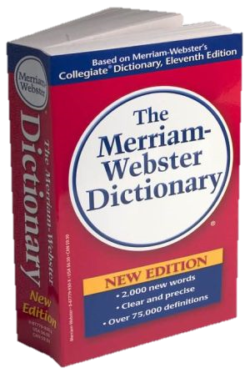
CodeSystem vs. ValueSet
“Dante’s deadly sins”
Pride
Envy
Wrath
Sloth
Avarice
Gluttony
Lust
Takes concepts from…
Definition of terms
An enumeration of terms
“Code System”
“ValueSet”
Example: SNOMED-CT
Example: “Childhood diseases”

Slide 35

“Special” cases
No need to write them all down!
Takes concepts from…
“All words under B”
“All words in the
Merriam-Webster dictionary”
Takes concepts from…
“Words for ‘nerd’”
Bookworm
Geek
Grind
Dork (slang)
Takes concepts from…
Can take concepts from multiple coding systems!

Slide 36
Terminology
Link Path
http://hl7.org/fhir/terminology-module.html
http://hl7.org/fhir/terminologies-conceptmaps.html
http://hl7.org/fhir/conceptmap-operation-translate.html
https://build.fhir.org/ig/HL7/davinci-ehrx/exchanging.html
Notes:
Show terminology diagram
Talk about binding strengths and ramifications
Demonstrate how to translate codes using the $translate operation
Show decision tree for driving decisions on interoperability approach
Totally ok/appropriate to support multiple approaches

Slide 37
International Patient Summary (IPS)
Notes:
Document-based approach to information sharing
Portable across all countries
WHO-sponsored

Slide 38
IPS topics
Resolution in Bundles
No conduction across references
FHIR Documents
Narrative
Signatures

Slide 39
International Patient Summary
Link Path
http://hl7.org/fhir/uv/ips/STU1
http://hl7.org/fhir/uv/ips/STU1/StructureDefinition-Composition-uv-ips.html
http://hl7.org/fhir/uv/ips/STU1/Bundle-IPS-examples-Bundle-01.html
http://hl7.org/fhir/documents.html
Notes:
Quick overview of the content of IPS
Examine a more complex example of slicing
Show what a FHIR document looks like

Slide 40
Documents – are bundles
Composition Resource
<Bundle>
<entry>
<resource>
<Composition />
</resource>
</entry>
<entry>
<resource>
<Observation />
</resource>
</entry>
<entry>
<resource>
<Device />
</resource>
</entry>
<entry>
<resource>
<List/>
</resource>
</entry>
<entry>
<resource>
<Condition/>
<resource>
</entry>
</Bundle>
Metadata
Attester
Section
Section
Section
Observation Resource
Device Resource
List Resource
Condition Resource
Notes:
Graph gets flattened to Bundle

Slide 41
When to use Documents?
Documents
Focus is on persistence
Data is ‘static’, managed by 1 person
No workflow involved
other than post/retrieve document
Need tight rules over authenticated content
Want to communicate multiple resources with control over how data is presented
Data spans multiple resources

Slide 42
Narrative considerations
When should there be narrative?
Generated or manual?
What to include?
all content needed for a human to understand the essential clinical and business information otherwise encoded within the resource
When to display?
Notes:
Generated easier for receivers
Examples of human-generated (e.g. Pathology reports)
Sometimes all you have is narrative
Modifier extensions, other extensions? Seek input
Don’t get complicated (different engines/devices)
Display driven by Narrative.status & business requirements (e.g. Document)

Slide 43
Signatures
"signature": [{
"type": [{
"system": "urn:iso-astm:E1762-95:2013",
"code": "1.2.840.10065.1.12.1.1",
"display": "Author's Signature"
}],
"when": "2016-05-26T00:41:10-04:00",
"who": {
"reference": "Patient/72"
},
"targetFormat": "application/fhir+xml",
"sigFormat": "application/signature+xml",
"data": "dGhpcyBibG9iIGlzIHNuaXBwZWQ="
}]
https://build.fhir.org/composition.html
https://build.fhir.org/datatypes.html#signature
Notes:
Don’t have to be digital
Bundle, Provenance or Extension
No requirement to sign
Messing with the data – not storing everything “exactly” can break signatures, even with canonicalization

Slide 44
PrescribeIT® messaging interface

Slide 45
PrescribeIT® topics
FHIR messaging

Slide 46
PrescribeIT®
Link Paths
https://specs.prescribeit.ca/R3.0/erx/erx.html
https://specs.prescribeit.ca/R3.0/erx/example-a1-401-e180.html
Notes:
Explain overall workflow
Walk through example
Profiles declared in instance
Message header info
Similarities to document
SAML info for provider
Use of Task to allow generic routing
Skim over medication details

Slide 47
Messages – are bundles
MessageHeader Resource
<Bundle>
<entry>
<resource>
<MessageHeader />
</resource>
</entry>
<entry>
<resource>
<Observation />
</resource>
</entry>
<entry>
<resource>
<Device />
</resource>
</entry>
<entry>
<resource>
<Patient/>
</resource>
</entry>
</Bundle>
source
destination
event
Observation Resource
Device Resource
Patient Resource

Slide 48
When to use Messaging?
Request/response workflow
Need to drive behaviors more complex than CRUD on a single resource
E.g. merge, complex queries
Need for asynchronous/indirect exchange
Need to communicate information about many resources but want to minimize exchanges
No “identity” for many resources
Messages
Notes:
Cost is heavy weight, negotiation

Slide 49
Structured Data Capture (SDC) LHC Forms
Notes:
Questionnaires are common to healthcare
SDC defines how to do advanced questionnaires
LHC is a SMART app that does that so EHRs don’t have to

Slide 50
SDC topics
REST as a platform for SMART
QuestionnaireResponse vs. other data

Slide 51
SDC & LHC Forms
Link Paths
https://lhcforms.nlm.nih.gov
https://lhcforms.nlm.nih.gov/sdc
http://build.fhir.org/ig/HL7/sdc
Notes:
Discuss notion of questionnaires vs. other resources
Show how ‘population’ works
Talk about data extraction
Why REST is important for SMART interfaces
Explore general SDC capabilities

Slide 52
Da Vinci Burden Reduction (CRD/DTR/PAS)

Slide 53
Da Vinci topics
Architecting complex flows
Implementation Guide scope & and re-use
HL7 IG publisher
IG Templates

Slide 54
Da Vinci IGs
Link Paths
https://build.fhir.org/ig/HL7/davinci-crd
https://build.fhir.org/ig/HL7/davinci-dtr
https://build.fhir.org/ig/HL7/davinci-pas
Notes:
Show how multiple IGs can inter-relate (also parent IGs US-Core and HRex)
Show a complex workflow and complete set of interrelated systems
Show how IGs can be published
Talk about IG templates

Slide 55
Bonus content

Slide 56
Combining paradigms
No requirement for a system to only support one paradigm
E.g. hospital may be primarily messaging, but use documents for discharge summaries and reports and expose registries and appointments via REST with a few custom services for decision support or specialized workflow
Data (generally) shared easily across paradigm boundaries

Slide 57
Caveats with combining paradigms
If updates come in via document, message or service, RESTful version id still needs to increment
Documents should typically be persisted whole, not reconstituted from parts
Ensures signature validity
Legacy messaging systems may not provide the metadata to easily expose or manipulate discrete resources via REST

Slide 58
Exchange options
v3
App
v2
FHIR
PHR
FHIR
Broker
Comm.
Interface
FHIR
DB

Slide 59
Repository model
HIS
LIMS
PACS
SystemX
Gateway
FHIR
FHIR
FHIR
FHIR
FHIR
Vendor Neutral Repository

Slide 60
Beyond Exchange
v3
Other
v3
v2
Other
v2
Decision Support
Broker
FHIR
FHIR
Repository
FHIR
X12

Slide 61
Variable Server capabilities
FHIR defines a number of mechanisms to give clients control of queries
Paging, many filters, _include, _summary, compartments
However, these are all optional . . .
What should a server do?
Cost/benefit trade-off
More you support, more clients will work with you
Some capabilities may be very expensive in some architectures
Do as much as you can, “within reason”

Slide 62
Variable Server capabilities (cont’d)
What should a client do?
Take advantage of desired capabilities, work with narrow set of servers
Works well in closed environments
Use minimal capabilities, work in most/all environments
Use advanced features where available, fallback to client processing where needed
More efficient but more complex client

Slide 63
Prohibiting data elements
In FHIR, you shouldn’t prohibit unknown extensions or unsupported data elements
You can set a maxOccurs=0 for data elements
This forces clients to customize what they send you – bad practice
Better to accept and ignore
In limited cases, may be liability issues with ignoring data, so rejecting is necessary

Slide 64
Interoperating with legacy
How do you make FHIR play nicely with v2, v3, CDA?
Not enough time to cover here
Look at
http://hl7.org/fhir/comparison.html
The mapping to v2 and CDA streams on http://chat.fhir.org

Slide 65

Estimating
How much will implementing a FHIR solution cost?
Considerations
Reference implementations help
Learning curve is lower
Still a curve if unfamiliar with XML / JSON / REST
Faster to “drive by” interoperability
Can’t speed consensus
Tools to help with mapping to internal codes and structures, still takes time
Anecdotal is “faster” to “significantly faster” to implement

Slide 66
Bundle decisions
Where’s the resource – bundled, contained, remote?
“contained” should only be used if resource can’t stand alone
Can’t exist if parent is removed
Not enough information to resolve
In bundle for document if part of narrative rendering rules or want part if signed content
In bundle for message if needed to process message and no separate query desired

Slide 67
Missing data
Extremely few resource or data type elements are required (minOccurs > 0)
Resources and data types are context independent
Extensions might supersede core elements
Therefore
Don’t assume data will be present
Always check for element/@value, not just element
May need to validate to a profile to enforce requirements

Slide 68
Looping
FHIR resources are interrelated in a network, not a hierarchy
Direct and indirect looping relationships are possible
In resource definitions & instances
Even if not possible with core elements, may occur with extensions
Parsing and processing algorithms must deal with this possibility

Slide 69

Education opportunities
Attend a Working Group Meeting
May. 24-28 Virtual (UK time)
Attend a Connectathon
May. 17-19 Virtual – ‘continuous’
FHIR Developer Days
Jun. 7-10 Virtual (U.S. time-zone)
Search “FHIR DevDays videos”
Custom education available

Slide 70
Learning Objectives
You should be able to:
Understand the different architectural approaches to using FHIR - and where to go to help decide the best approach for a given use-case (includes SMART, CDS Hooks, etc.)
Describe some of the considerations around persistence models when exposing a FHIR interface
Explain the technologies that FHIR provides to support terminology interoperability
Know the technologies that FHIR provides to document and define FHIR interfaces
Choose how best to leverage the FHIR community and maximize interoperability with existing solutions

Slide 71

Questions?
http://hl7.org/fhir lmckenzie@gevityinc.com

